Slide 1
Database System

Slide 2
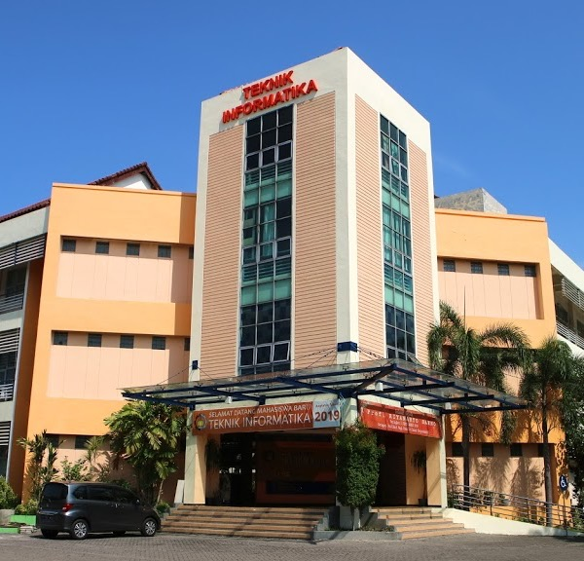
Conceptual Modeling
Database System
Tim Pengajar Sistem Basis Data 2020/2021

Slide 3
Database Design
Conceptual Design
Database Design
Physical Design

Slide 4
Conceptual Design
Investigation
Business needs
Data used
Data Model
Business process data representation
Verification
Business needs verification with data model
CDM Diagram
Focus: Business need concepts, no discussion about software and hardware

Slide 5
Steps in designing database
1. Requirement definition
2. Conceptual design
3. Implementation design
Identify and describe data needs
Creating conceptual model to satisfy different users.
4.Physical design
Mapping logical data model to a certain DBMS
Logical database structured (normalized relation, trees, network, etc) is mapped into physical storage structure such file and table.

Slide 6
Conceptual Design Diagram: Entity Relationship (ER) & Conceptual Data Model (CDM)

Slide 7
Conceptual design
It is used to describe the logical database structure in detail.
This structure is independent to all types of software or data storage structure.

Slide 8
Component of Conceptual Design
Entity: define an object or event
Example: Student, Lecturer, Course
Attributes/property: data item as the characteristic of an entity.
Example: Student has : NRP, Name, DOB, Phone, Email etc
Relationship: the association between entity
Example: relationship supervising atau guardian between Lecturer and STUDENT
Constraints : is used to protect data integrity (such as to protect error when filing up the data)

Slide 9
Term Change
Conceptual | Physical
Entity | Table
Attribute | Column
Tuple | Row / record

Slide 10
Entity

Slide 11
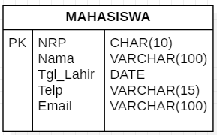
Entity
It is an object in real life and can be distinguished from one another (unique).
It has atribut to describe its characteristic.
Example:
Entitay | Attribute
Student | NRP, Name, DOB, Phone, Email

Slide 12
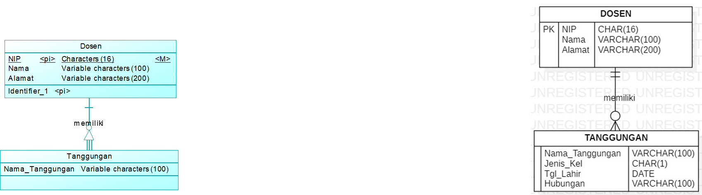
Tipe Entitas
Strong Entity
Some attributes will be primary key
Example: Lecturer
Weak Entity
It used attributes from other entity (foreign key) as primary key
Example: Children depend on Lecture
If you delete a lecturer dara, so does its children. The existence of Children is depend on Lecturer

Slide 13
Attribute

Slide 14
Type of attributes
Primary key, one or more attributes with unique value to distinguish the data in an entity
Single value attribute, it has only one value.
Multi value attribute, it has several value
Composite attribute, it consist of several smaller attribute
Derivative attribute, it is obtained from other attributes

Slide 15
Relationship

Slide 16
Relationship
The association between entities
Degree of relationship: number of entities related in one relationship
Unary → 1 entity
Binary → 2 entites
Ternary → more than 2 entities

Slide 17
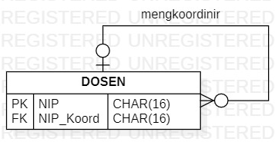
Unary → 1 entity

Slide 18
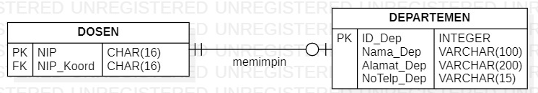
Binary → 2 entities

Slide 19
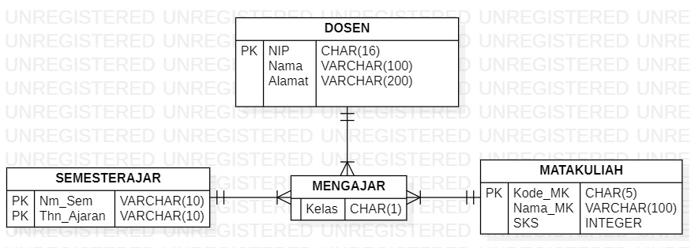
Ternary → more than 2 entities

Slide 20
Cardinality: One-to-one

Slide 21
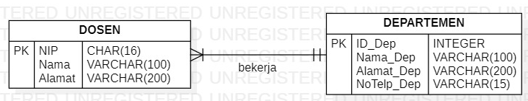
Cardinality: One-to-many

Slide 22
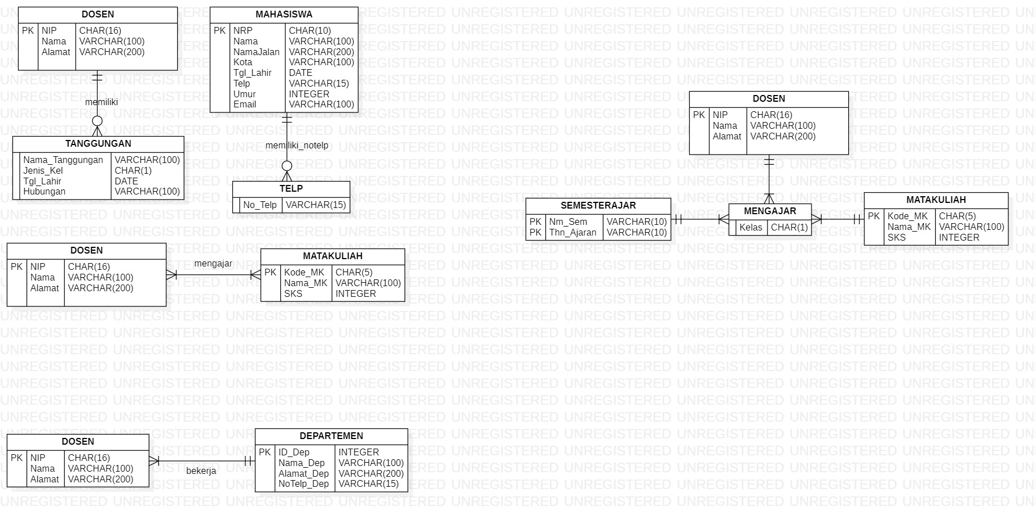
Cardinality: Many-to-many

Slide 23
Entity Participation

Slide 24
1. Total Participation
All DOSEN has to teach at least one MATAKULIAH. Minimal cardinality 1

Slide 25
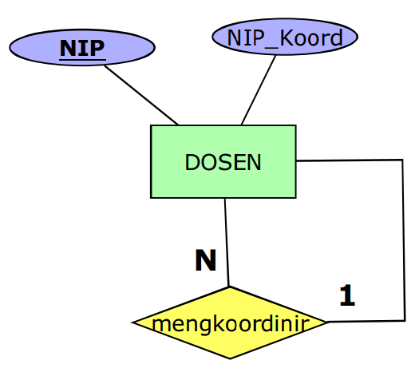
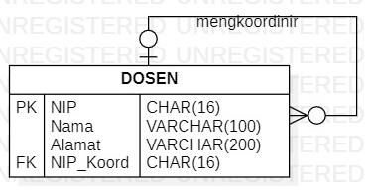
2. Partial Participation
Some DOSEN coordinate other dosen, but not every dosen has to coordinate other dosen. Minimal cardinality 0.

Slide 26
Tools
CDM
Licensed: PowerDesigner (Sybase)
Open source:
StarUML (http://staruml.io/download)
Oracle data modeler
Vertabelo (https://vertabelo.com/)

Slide 27
Practice
We currently manage three guest houses, namely Flamboyan, Bougenville and Jasmine. However, the management of the three guest houses is still carried out separately in each of the guesthouses. We hope that in the future this management process will be incorporated into an integrated system.
The current process is that guests must come to the guesthouse they want to go to to be able to place an order. Next, the guest will check-in on the D day and choose the appropriate room type and leave an ID card so that the receptionist can record the identity, room and check-in date. For our Flamboyan and Bougenville guesthouse, we have several types of rooms. Especially for Jasmine guesthouse, this guesthouse is rented out for one house. At check-out, the receptionist will calculate how long the stay is, and whether there are additional facilities used, such as extra beds. After the payment is completed, the identity card will be returned. To improve the service of the guesthouse, every guest who checks out is asked to fill out a customer satisfaction questionnaire such as satisfaction with receptionist service, room cleanliness, hospitality of the guest house staff, room comfort, etc.

Slide 28
THANK YOU

